Slide 1
Heuristic Search Techniques

Slide 2
Heuristic Search
Are a set of general purpose search techniques.
Can be described independently of any problem domain.
Their efficacy is highly dependent on the applied problem domain since they are unable to overcome combinatorial explosion.
Two methods already discussed (DFS and BFS).

Slide 3
Generate and Test
Algorithm: Generate and Test
Generate a possible solution. For some problems, this means generating a particular point on problem space. For others, it means generating a path from start state.
Test to see if it is actually a solution by comparing the chosen point or end point of chosen path to the set of acceptable states.
If solution has been found quit. Otherwise return to step 1.
Is a DFS procedure.

Slide 4
Example: Colored Blocks Problem
Four six sided cubes each side of the cube painted one of the four colors.
Task: arrangement of the cubes in a row such that on all four sides of the row one block face of each color is showing.
Solution: There are more, say, red faces than there are any colors. While placing a block with red faces use as few of them as outside faces.

Slide 5
Hill climbing
In pure generate and test procedure, the test function responds only with yes or know.
Hill climbing is a variant of generate and test in which the feedback from the test procedure decides the direction of search process.
Test function is augmented with a heuristic function to provide an estimate of how close a given state is to the goal state.

Slide 6
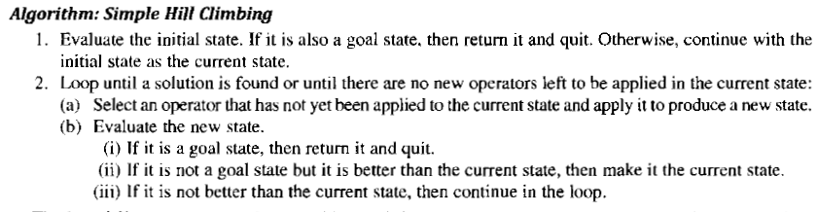
Simple Hill Climbing

Slide 7
Colored Blocks Problem Revisited
Heuristic function: Sum of the number of different colors on each of four sides ( value 16 in this case).
Rule: Pick up a block and rotate it 90 degree in any direction.
Application of hill climbing: Generate a new state by selecting a block and rotating it. If the resulting state is better, keep it. If not return to the previous state an try a different combination.

Slide 8
Steepest Ascent Hill Climbing
Variant of Hill climbing technique.
Consider all the moves from the current state and select the best one as next state.
For application of this method in colored blocks problem, all combinations must be considered from initial state which is impossible since it is huge.

Slide 9
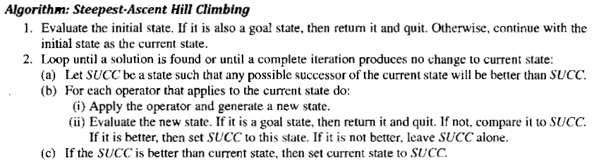

Slide 10
Both of these may fail to find a solution….
A local maximum is a state that is better than all its neighbors but is not better than some other states far away.
A plateau is a flat area of the search space in which a whole set of neighboring states have the same value.
A ridge is an area of the search space that is higher than surrounding areas and that itself has a slope.

Slide 11
Ways of dealing with these…
Local maxima: Backtrack to some earlier node and try going in a different direction.
Plateau: Make a big jump in some direction to try to get to a new section of the search space.
Ridges: Apply two or rules before doing a test.

Slide 12
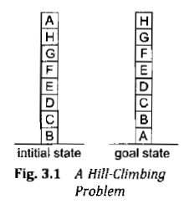
Example: Blocks World
Local: Add one point for every block that is resting on the thing it is supposed to be resting on. Subtract one point for every block that is sitting on the wrong thing.
Goal state: score 8.
Initial state: score 4.
Next move: Move block A to the table (produces score 6).

Slide 13
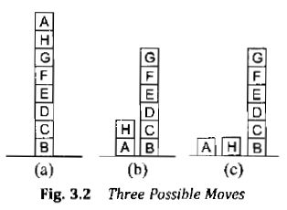
Leads to 3 possible moves.
The states have scores of (a) 4 (b) 4 (c) 4.
Process reached local maxima which is not global maxima.
Global: For each block that has the correct support structure add on point for each block in the support structure. For each block that has incorrect support structure subtract the same.

Slide 14
Goal State has score 28 ( 1 for B, 2 for C, etc).
Initial state has score -28.
Move A to the table yields score -21 ( -1 for C, -2 for D etc).
The states (a), (b), (c) respectively produces scores of -28, -16 and -15 indicating that the best next state is (c) which is correct.

Slide 15
Best First Search
DFS is good because it allows solution to be found without all competing branches having to be expanded.
BFS is good because it does not get trapped in dead end paths.
BFS combines the effectiveness of both by following a single path at a time but switching paths when some competing path looks more promising than the current one.

Slide 16
How does it work?
At each step of the search process the most promising node is selected by applying an appropriate heuristic.
The node is then expanded using appropriate set of rules.
If it is the solution then the search process stops.
Otherwise all the new nodes are added to the set of nodes generated so far.
Again the most promising node is selected and the process continues.

Slide 17
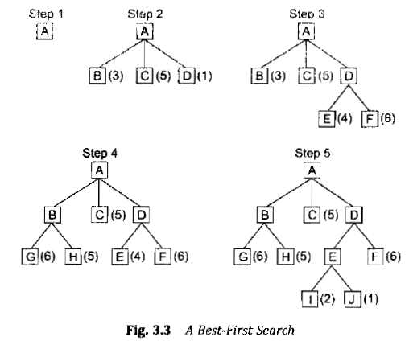
Example

Slide 18
The heuristic function is an estimate of the cost of getting to the solution from a given node.
BFS is applied on a directed graph in which each node represents a point in problem space. Each node contains a description of the problem state, an indication how promising it is, list of nodes generated from it and the parent link.
Such a graph is called an OR graph, since each branch represents an alternate problem solving path.

Slide 19
Two list of nodes are required....
OPEN: nodes that have been generated and have had the heuristic function applied on them but have not yet been examined(i.e. their successors generated).
CLOSED: nodes that have been examined.

Slide 20
Heuristic Function….
Estimates the merit of each node generated.
Indicated as f1.
Defined as the sum of two functions g and h1.
g is a measure of the cost of getting from initial state to current state.
H1 is the estimate of the cost of getting from the current node to the goal state.

Slide 21
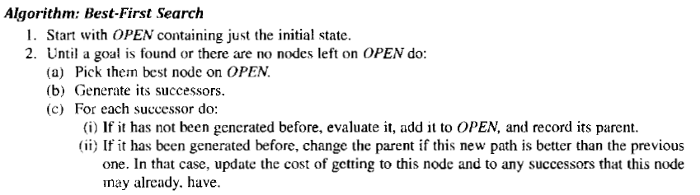

Slide 22
Agenda Driven Search
In the discussion of OR graphs, it was assumed that we could evaluate multiple paths to the same route independently of each other (for example, water jug problem).
Multiple paths are of no significance.
Consider problems like mathematics discovery program AM, which is given a small set of starting facts about number theory and the set of operators that could be used to develop new ideas.
Several paths lead to the same task, matters in this case.

Slide 23
What is agenda?
Each path contributes a reason why the task would lead to an interesting result.
More the reason, better it is.
An agenda is a list of tasks a system could perform.
Two things associated with each task: a list of reasons why the task is proposed (called justification), and a rating suggesting how useful it would be.

Slide 24
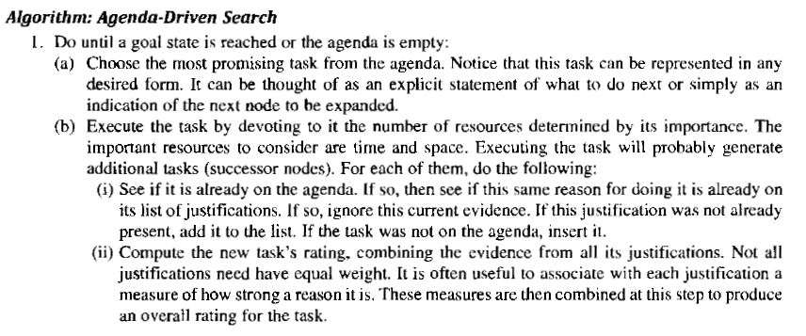

Slide 25
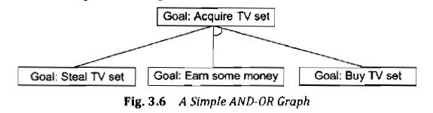
Problem Reduction
OR graphs work on the strategy that we want to find a single path to a goal.
AND-OR graphs are useful in solving problems that can be decomposed into a set of smaller sub problems and then be solved.
The decomposition (reduction) generates arcs called AND arcs.

Slide 26
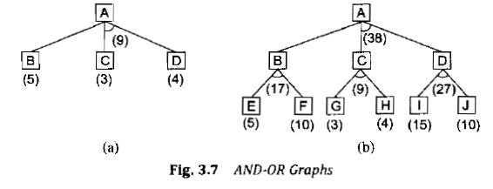
BFS cannot be used for problem reduction….

Slide 27
Choice of which node to expand next depends not only on the f1 value but also on whether the node is a part of current best path from the initial node.
A value called FUTILITY is used to determine the efficiency of search.
If the estimated cost of solution becomes greater than the value of FUTILITY, the search is abandoned.

Slide 28
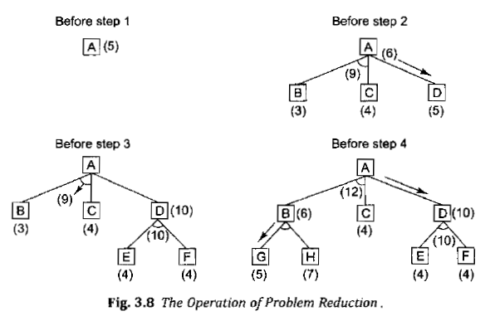

Slide 29
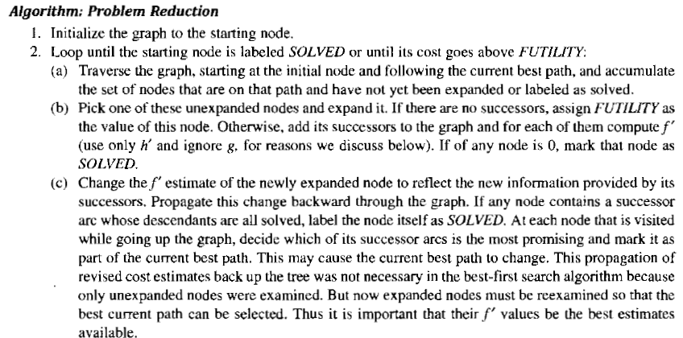

Slide 30
The AO* Algorithm
Only one list will be used for searching purpose.
GRAPH: representing the part of search graph that has been explicitly generated so far.
Only h1 will be required for the search.
G values cannot be computed as there may be multiple values to the same state.

Slide 31
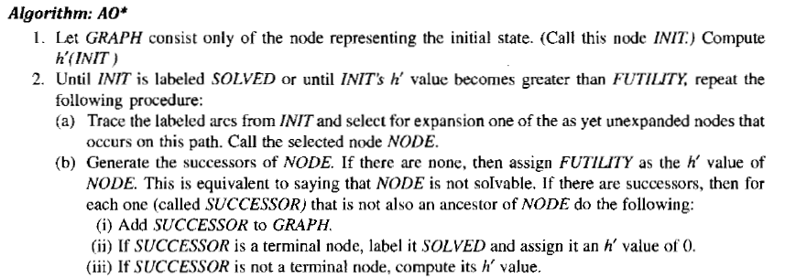

Slide 32
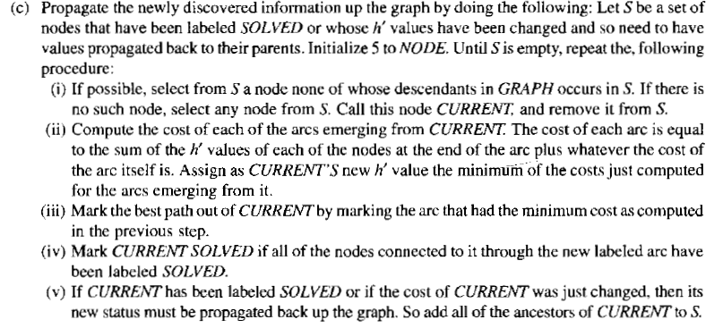

Slide 33
Constraint Satisfaction
Goal is to discover some problem state that satisfies a given set of constraints.
Ex: Cryptarithmetic puzzles.
Is a search procedure that operates in a space of constraint sets.
Initial state: problem description.
Goal state: problem solved following constraints.
Two step process.

Slide 34
First, constraints are discovered and propagated as far as possible throughout the system.
Second, if the solution is not yet found a guess is made and added as a new constraint.
Constraint propagation terminates for one of the two reasons. First, a contradiction is detected. Second, propagation has run out of steam and no further changes can be made on the basis of current knowledge.

Slide 35
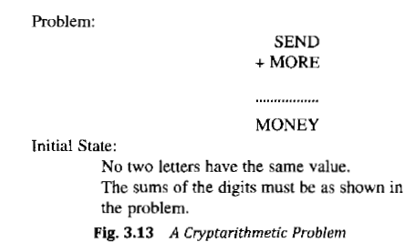

Slide 36
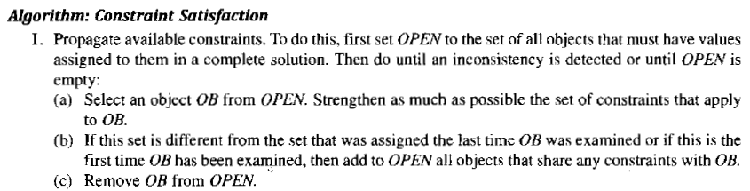

Slide 37
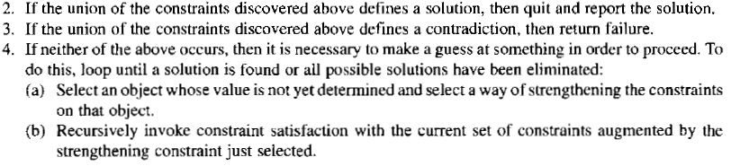

Slide 38
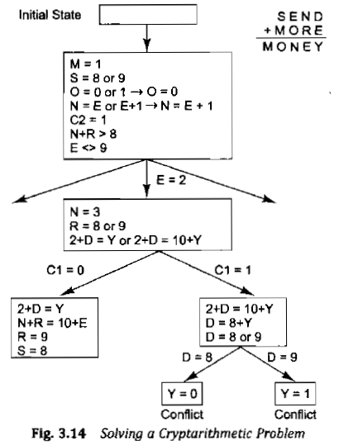

Slide 39
Means End Analysis
Previous algorithms used either forward or backward reasoning.
MEA uses a mixture of these two techniques.
Major parts of the problem are solved first and then these parts appended to get the solution.
Difference between current state and goal state is to be detected.

Slide 40
Operator to be applied to reduce this difference.
But this operator may not be applicable to the current state.
This kind of backward chaining in which operators are selected and then sub goals are set up to establish the preconditions of the operators are called operator sub goaling.
If the operator does not produce the goal state we want then the same process is applicable.
Thus the process can be applied recursively.

Slide 41
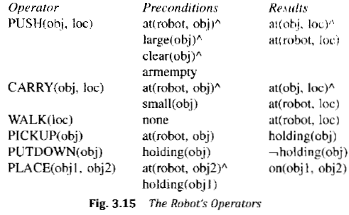

Slide 42
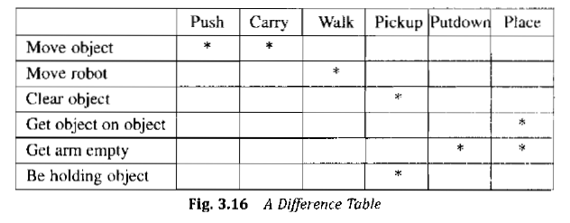

Slide 43
Ex: Moving a desk with two things on it.
Push or Carry operators may be used.
Preconditions not satisfied for carry(as object is not small).
Preconditions for push satisfied.

Slide 44
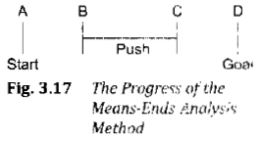
Ex: Moving a desk with two things on it.
Push or Carry operators may be used.
Preconditions not satisfied for carry(as object is not small).
2nd and 4th preconditions for push satisfied.
For 3rd and 4th preconditions to be satisfied pickup and putdown operators are required.

Slide 45
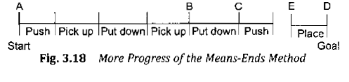

Slide 46
